Slide 1

SMART INDIA HACKATHON 2024
Problem Statement ID – SIH1704
Problem Statement Title – Gamification for Rural Planning Using Drone Land Survey Maps And GIS Data
Theme-Robotics And Drones
PS Category- Software
Team ID-
Team Name -Rural Innovators

Slide 2
Abstract
1. Objective: Explore the use of gamification in rural planning with drone land survey maps and GIS data.
2. Method: Develop a gamified platform using real-time drone imagery and GIS analytics.
3. Features:
Scenario-Based Challenges: Users test various land-use strategies.
Reward System: Incentives for effective planning solutions.
4. Initial Findings: Gamification improves understanding of complex spatial data and planning accuracy.
5. Impact: Makes planning more engaging and accessible for both experts and community stakeholders.

Slide 3
Features
Drones- High resolution image , automatic fight , advanced sensors , GIS (mapping of specified image)
Gamification- Mechanic engagement ,challenges and reward component of education
Automated Data Processing
Interactive Dashboards
Security and Privacy

Slide 4
Proposed System
Detailed explanation of the proposed solution
Problem identification and Real-Time Data collection using drone
GIS-Mapping and Data Analysis
Real time monitoring and feedback loop
Predictive modeling system
Engagement through Gamification

Slide 5
Detailed Explanation of the Proposed Solution
Rural Innovators
Addresses the Problem:
Facilitates participatory planning by allowing users to simulate Gram Panchayat Development Plans (GPDP).
Encourages a holistic view of resource allocation and sustainable village development.
Innovation and Uniqueness:
Real-world integration of GIS and drone data.
Interactive 3D simulation with budget estimation, real-time feedback on planning decisions.
Localization of Sustainable Development Goals (SDGs) at the grassroots level.

Slide 6
TECHNICAL APPROACH
Rural Innovators
Technologies to be Used:
Game Development Platform: Unity/Unreal Engine
Languages: C#, Python
Frame-works: Flask/Django, Tensor flow (AI frame work),OpenCv,Mapbox,Celery
GIS Integration: Mapbox
Hardware : Drone , GPU (Trainning to AI),Computing device (processing data from drones), IOT sensor’s
Methodology and Process:
Superimpose GIS/drone data for 3D village modeling.
Resource allocation mechanism based on various development activities.
Develop budget calculation algorithms and cost estimations.

Slide 7
FEASIBILITY AND VIABILITY
Rural Innovators
Feasibility:
Use of open-source GIS tools and affordable game engines.
Drone data from the SVAMITVA scheme provides real-world, usable data.
Challenges:
Complexity in rendering large data sets.
Ensuring smooth user experience on mobile platforms.
Strategies:
Optimize data visualization.
Test on multiple devices to ensure performance.

Slide 8
IMPACT AND BENEFITS
Rural Innovators
Impact:
Empowers local citizens, especially youth, in planning and decision-making.
Promotes transparency and participatory governance at the grassroots level.
Benefits:
Improves planning efficiency in rural development.
Aligns village planning with SDGs.
Enhances social, economic, and environmental development.
Boosting innovation and Creativity
Enhanced Creator IQ power , learning and Awareness
Game based element users learn more about rural development

Slide 9
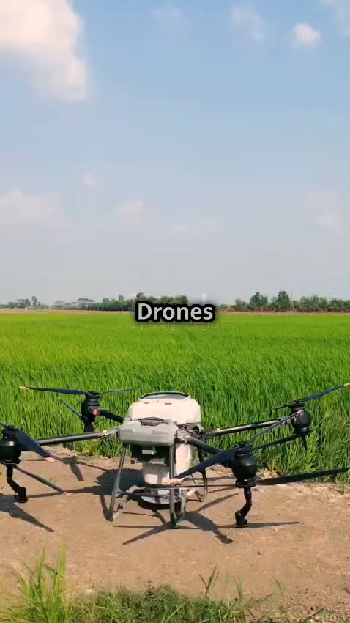
Methodology and Process

Slide 10
THANK YOU

